Slide 1

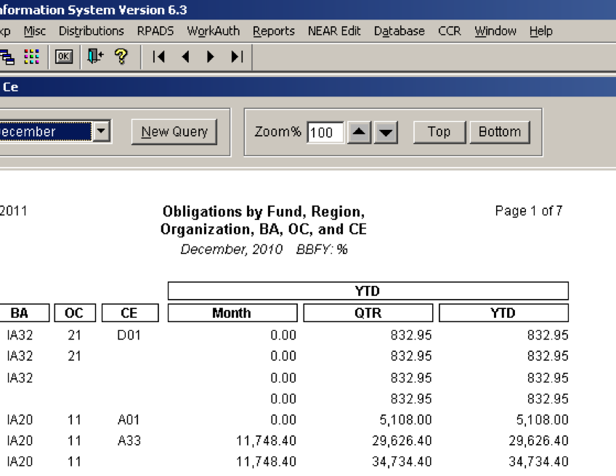
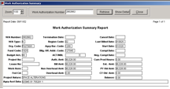

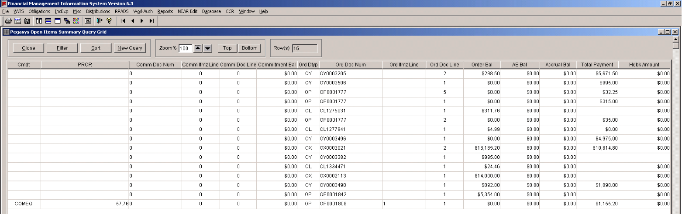
Non-Query Grids/Reports
Under the ‘Obligations’ menu item, there is a group of non-query grids allowing users to create obligation reports. For example, in the ‘Obligations’ menu, ‘Obl Fund Rg Ba Org Fc Oc Ce’ is the report of Obligations by Budget Activity, Organization, Function, Object Class and Cost Element.
PEGASYS OPEN ITEMS SUMMARY AND DETAIL
Located in the ‘Misc.’ menu, the Pegasys Open Items Summary allows users to obtain the obligation/order open balance, the accrual/receipt open balance and/or total of all payments for a particular Order/Accounting Line as long as there is an open balance on the order or up to 30 days after it is closed.
The Open Items Detail allows users to search for all documents from Request, Purchase Order, Receipt and Payments.
If a user enters a Purchase Request Document Number the query will return all documents that link to that Purchase Request. If a user enter a payment document number, the query will return all receipts, orders and requests (when applicable).
PEGASYS TRIAL BALANCE DETAIL AND SUMMARY
Also in the ‘Misc.’ menu, this query grid allows users to view Pegasys Trial Balances in detail as well as in summary. With the detail query grid, users will view the month’s activity in the Trial Balance. The summary Trial Balance allows users to view Prior Month Close, Change in the current month and Year to Date Balance.
WORK AUTHORIZATION
The WorkAuth menu contains data pertaining to RWAs imported from the RWA database. The Work Authorization Summary will combine the most useful fields from the first two query grids and display on one screen with an option to look at detail when needed.
From the WorkAuth menu, click ‘Work Authorization Summary.’ Enter an RWA number or part of the number in the criteria window (Note: users do not need to use the operator ‘LIKE’ or ‘%’ when indicating a wildcard). If a user needs to see the detailed transactions that support the amounts, click the ‘Show Detail’ button.
RPADS AND RPADS CAPITAL REPORT
In the ‘RPADS’ menu, the RPADS Query Grid and the RPADS Capital Report capture depreciation and capitalization information for all buildings for Fund 192X.
U.S. General Services Administration
The Financial Management Information System
Figure 7: Obl Fund by Rg, Org, Ba, Oc, Ce Report
Figure 9: Work Authorization Summary Report
FREQUENTLY USED QUERIES
QUICK REFERENCE CARD
This Quick Reference Card is designed to provide users of FMIS with an understanding of Frequently Used Queries, and the data available within each.
KEY TAKE-AWAYS: To understand how and when to use the most frequently-utilized queries in FMIS
Last Updated: March 2011
FMIS RESOURCES
FMIS User Guide
FMIS Quick Reference Cards:
For additional support with FMIS, please contact the OCFO Service Desk at ocfoservicedesk@gsa.gov
Figure 8: Pegasys Open Items Summary Query Report

Slide 2
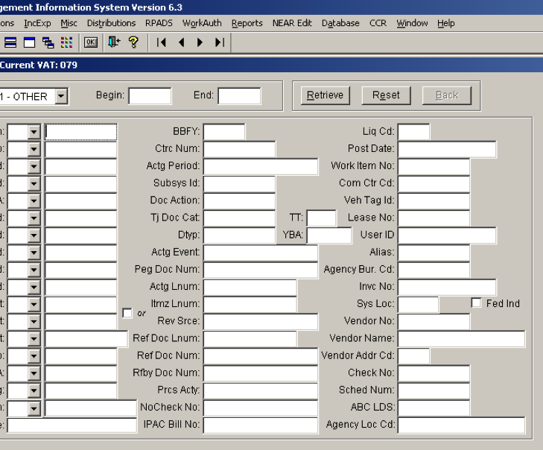
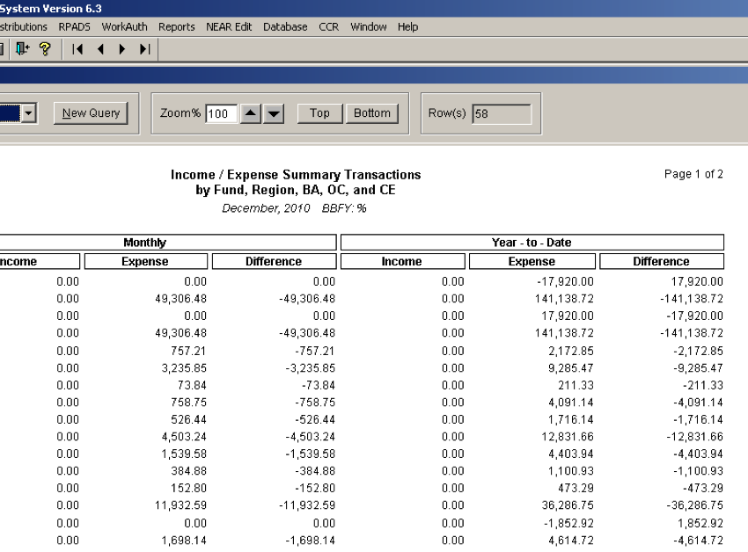
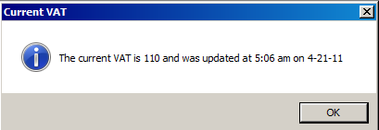
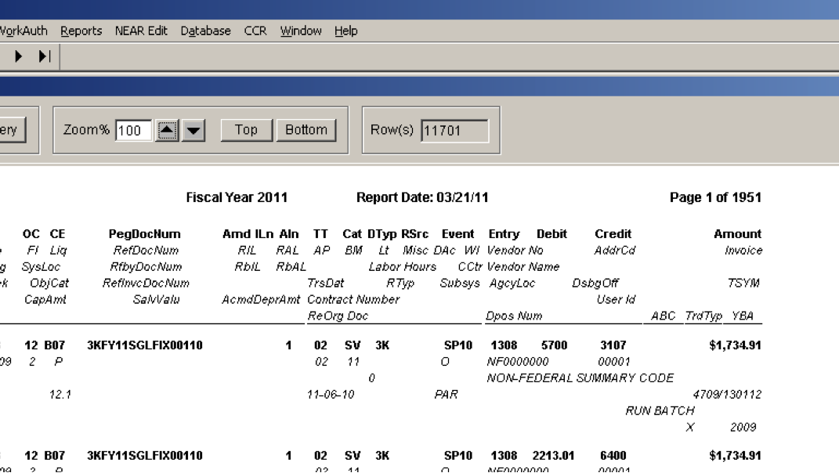
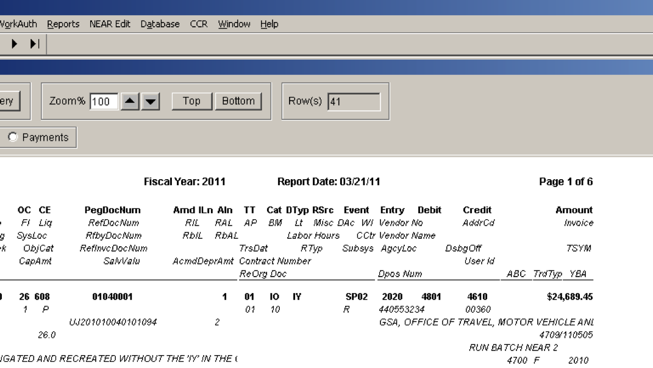
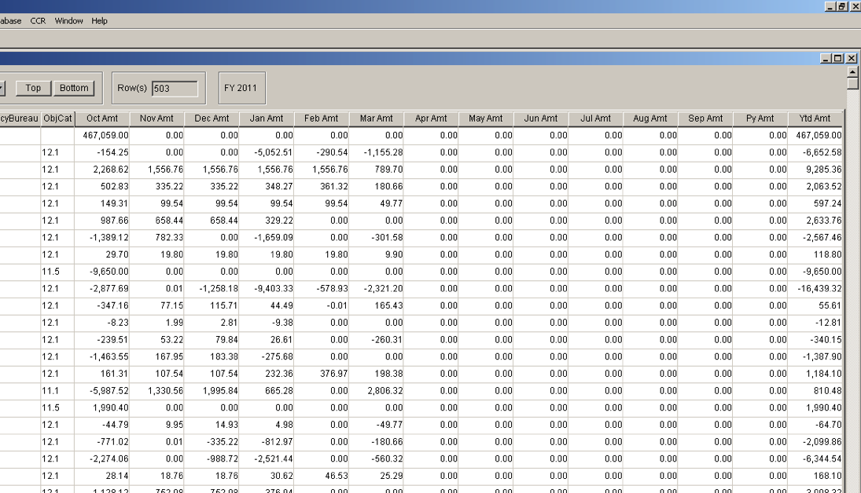
LIST OF VAT NUMBERS
This query will allow users to see all VATs being processed in each fiscal year and their details. The FMIS database holds all VATs for five years. To view, at the main FMIS menu, click ‘VATS’ and select ‘List of VAT Numbers.’
In order to maximize use of this query, it is important to note the last time the current VAT list was updated. Users can note this information upon log-in to FMIS when the box below appears.
PEGASYS VAT QUERY GRID
In the VAT menu, users will find the same query grids available for researching the Pegasys VAT. In the VAT query grids, all Pegasys data elements are available. There are additional Pegasys-centric data elements such as Pegasys Document Number, Document Type, Document Category, Transaction Type, and Accounting Event in addition to account line dimensions.
VAT SEARCH
This screen allows users to extract Pegasys transactions with all query fields condensed on one screen. It returns the same data as the Pegasys VAT Query Grid, but uses a different query format.
Click ‘VATS’ and choose ‘VAT Search.’ Users will need to input a value for at least one of the required fields marked with an asterisk (*). The result is the same as that of the VATS Query Grid with Filter and Sort functions.
Figure 5: Income and Expense Query Report
Figure 1: Current VAT Update Status
Figure 3: VAT Search Non-Query Grid
OBLIGATIONS
The ‘Obligations’ menu contains query grid and non-query grids that extract Obligations and Delivered Orders by book month. Transactions are displayed in monthly columns at a summarized level.
Query Grid
The Obligations Query Grid allows users to enter any combination of the input criteria. At the main FMIS menu, click ‘Obligations,’ and choose ‘Query Grid.’
Non-Query Grids/Reports
Under the ‘Obligations’ menu item, there is a group of non-query grids allowing users to create obligation reports. For example, in the ‘Obligations’ menu, ‘Obl Fund Rg Ba Org Fc Oc Ce’ is the report of Obligations by Budget Activity, Organization, Function, Object Class and Cost Element.
TRANSACTIONS BY DOCUMENT NUMBERS
Because of the unavailability of ACT Numbers in Pegasys, this query will provide users with accounting transactions/entries for all documents that are related to the input document. Click on ‘VATS’ and choose ‘Transaction by Document Number(s).’ Enter a Purchase Order number and click ‘PO’ and the FY of interest. The report will show the purchase order as well as associated receipts. If there is any payment, the report will also present that.
INCOME AND EXPENSE
The ‘IncExp’ menu contains Query Grid and Canned Queries that extract Income and Expense information. The Income Expense Query Grid includes monthly columns and the amount consolidated at a summarized level.
Figure 2 Pegasys VAT Query Grid Report
Figure 4: Transactions by Document Numbers Report
Figure 6: Obligations Query Grid Report

